Slide 1

Experiential Learning Project Assessment-I on
“English dictionary”
under the course
Python Programming Language (N-PCCCM304P)
Presented By:-
Khushi L. Thakur
Under the Guidance of
Mrs. Mayuri Getme
Session:2026-27 (ODD )
Department of CSE(AI&ML)
S. B. JAIN INSTITUTE OF TECHNOLOGY MANAGEMENT AND
RESEARCH,NAGPUR
An Autonomous Institute, Affiliated to RTMNU, Nagpur
)
S. B. Jain Institute of Technology Management and research

Slide 2
Problem statement
Finding the meaning, pronunciation, synonyms, antonyms, and example sentences of English words manually can be time-consuming. Users may also enter words with incorrect spellings while searching.
The aim of this project is to develop a simple English Dictionary Application using Python and a Dictionary API. The application allows users to enter any English word and retrieve its meaning, pronunciation, synonyms, antonyms, and example sentences. It also provides suggestions for misspelled words and maintains the user's search history.
S. B. Jain Institute of Technology Management and research

Slide 3
Objectives
To develop an English Dictionary Application using Python.
To integrate a Dictionary API with the Python application.
To allow users to search for English words easily.
To display the meaning of the searched word.
To display the pronunciation of the word.
To provide synonyms and antonyms of the searched word.
To display example sentences for better understanding.
To provide suggestions for incorrectly spelled words.
To use Python concepts such as functions, loops, lists, dictionaries,
and conditional statements.
To use file handling for maintaining search history.
To handle errors such as invalid words, network problems, and API errors.
To provide a simple and user-friendly interface.
S. B. Jain Institute of Technology Management and research

Slide 4
Algorithm
Start the program.
Create the user interface using Python.
Ask the user to enter an English word
Validate the entered input.
Send the entered word to the Dictionary API using an HTTP request.
Receive the response from the API in JSON format.
Check whether the requested word is available.
If the word is found extract all meanings and all.
Display the extracted information on the application interface.
N
SELECT OPERATION
UP
DATE DATA
SAVE JSON
REPEAT / EXIT
S. B. Jain Institute of Technology Management and research

Slide 5
If the word is not found, display an appropriate error message.
Provide possible spelling suggestions for an incorrectly entered word.
Store the searched word in the search history using file handling.
If the user selects no, terminate the application.
If the user selects yes, repeat the search process.
Ask the user whether they want to search for another word.
End the program.
S. B. Jain Institute of Technology Management and research

Slide 6
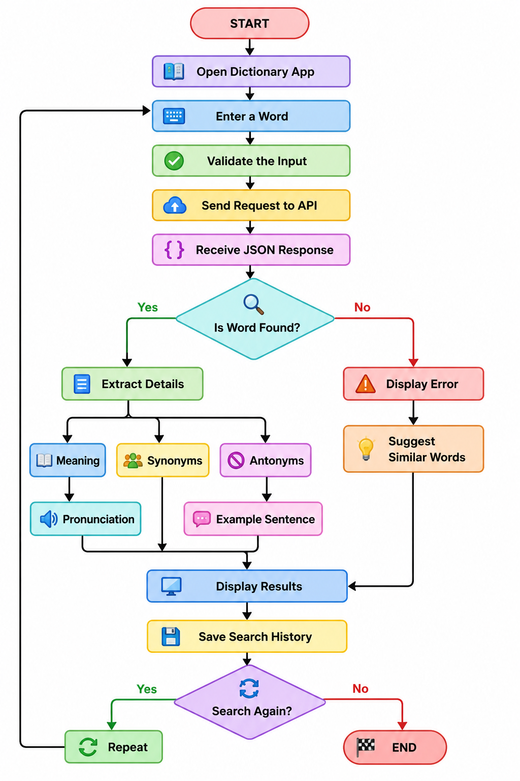
Flowchart
S. B. Jain Institute of Technology Management and research

Slide 7
Understanding of pythan login
The project demonstrates the practical use of various Python programming concepts:
Variables: Used to store user input, API responses, and results.
Functions: Used to divide the program into smaller and reusable tasks such as searching and displaying results.
Conditional Statements: Used to check whether the entered word is available and whether the API request is successful.
Loops: Used to process multiple meanings, definitions, synonyms, and antonyms returned by the API.
Lists: Used to handle multiple synonyms, antonyms, and definitions.
Dictionaries: Used to access and process the structured JSON data received from the API.
S. B. Jain Institute of Technology Management and research

Slide 8
Requests Library: Used to send HTTP requests to the Dictionary API.
JSON: Used to read and process the data received from the API.
File Handling: Used to store and retrieve the user's search history.
Exception Handling: Used to handle errors such as network failures, invalid responses, and connection problems.
Difflib Module: Used to find similar words and provide spelling suggestions.
Tkinter: Used to create the graphical user interface of the application.
Thus, the project helps demonstrate how basic Python programming concepts can be combined with an API to develop a practical real-world application.
S. B. Jain Institute of Technology Management and research

Slide 9
GITHUB & VERSION CONTROL
Create a GitHub account and set up a new repository for the project.
Upload the project code, along with a README explaining setup and usage.
Make meaningful, incremental commits that describe each change (e.g.,
"Add encryption function", "Add error handling").
Collaborate using branches and pull requests when working with a team.
Track individual contribution through commit history so each member's work is visible.
S. B. Jain Institute of Technology Management and research

Slide 10
Thank You
S. B. Jain Institute of Technology Management and research

